Slide 1
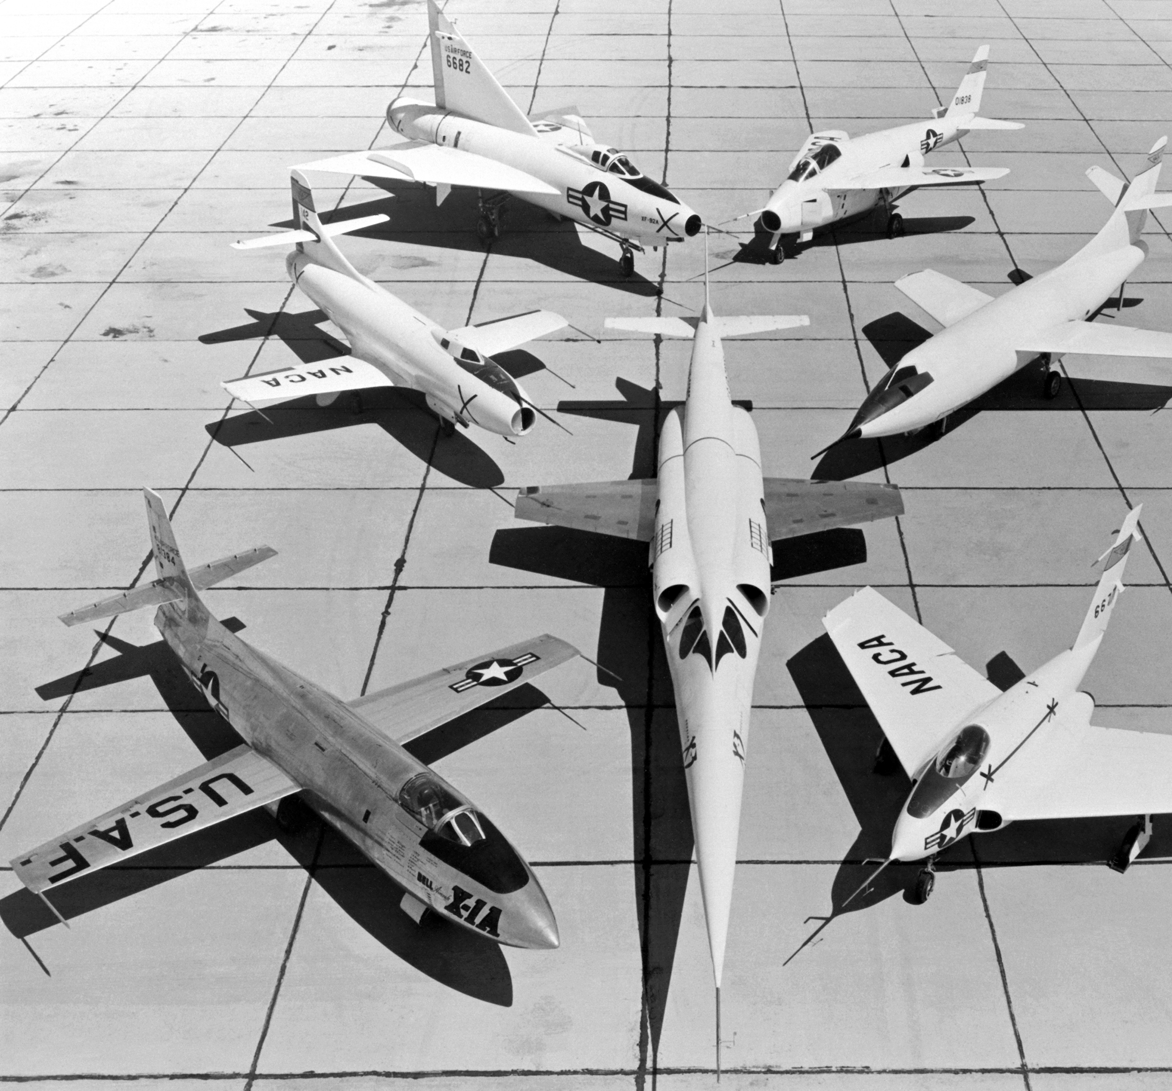

Public class AvajLauncherPresentation
{
Public string member_1 = anoroita;
Public string member_2 = sriti;
Public string member_3 = mbond;
Public string member_4 = cmatshiy;
Public string groupMembers[ ] =
{member_1, member_2, member_3, member_4 }
Public void Present(groupMembers)
{...}
public class Program {
public static void main(String[] args) {
AvajLauncherPresentation CodersCup = new AvajLauncherPresentation;
CodersCup.Present();
} }

Slide 2
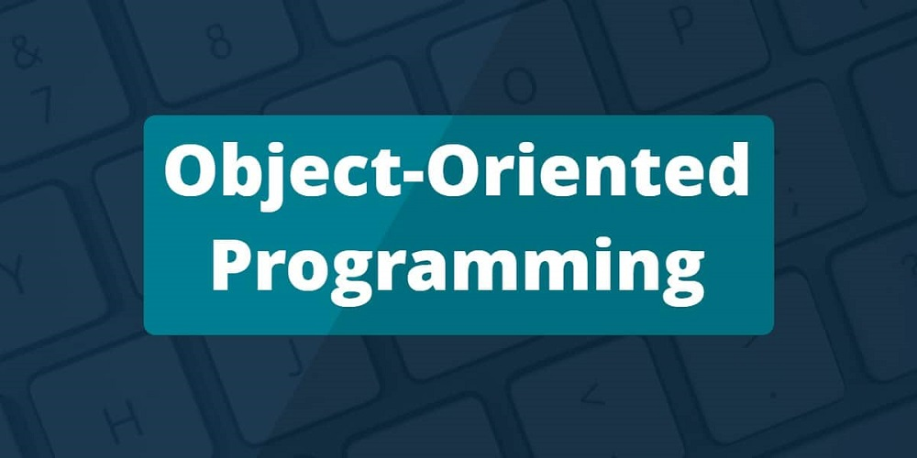


PROJECT OBJECTIVES()
{ENTER THE JAVA PATH}
To implement a minimal aircraft simulation program based on a given UML class diagram.
{
INTRO TO OOP VS C programming;
INTRO DESIGN PATTERNS;
INTERPRET && IMPLEMENT UML DIAGRAMS;
}
NEW_CONCEPTS
{
Classes
Properties
Methods
Objects
Inheritance
Interfaces
Polymorphism
Access_modifiers
}
{USE NEW JAVA TOOLS}
1 0f 4

Slide 3
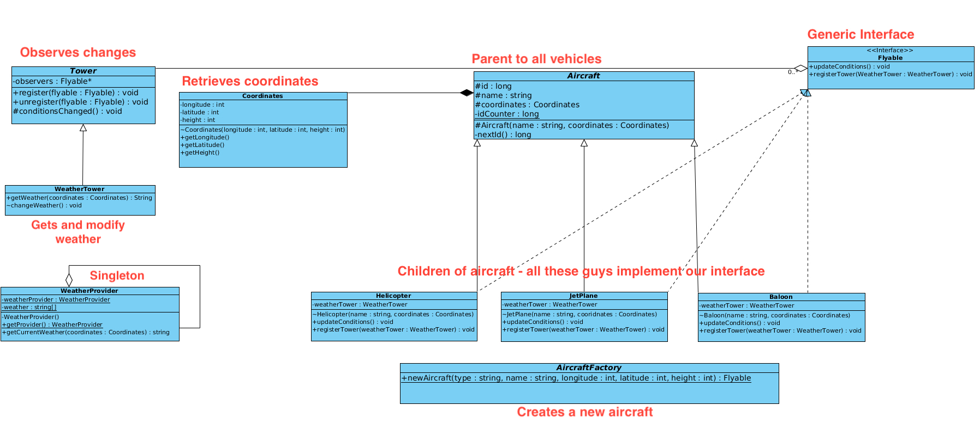
{UMLDIAGRAM}
Unified Modeling Language

Slide 4
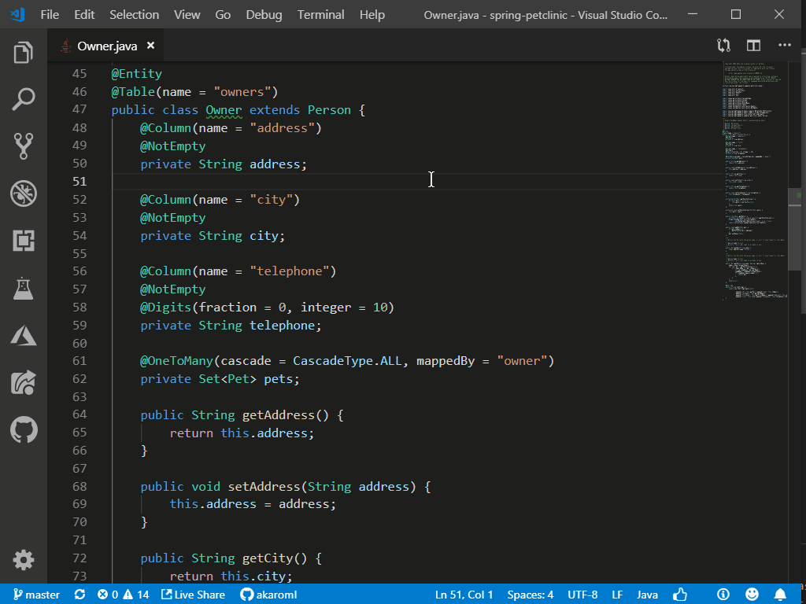
{Code Implementation}
{
CREATE RELEVSNT PACKAGES;
SCENARIO FILE;
WEATHER GENERATION;
AIRCRAFTS;
SIMULATION;
INPUT VALIDATION;
}
{BONUS PART}
{
CREATE CUSTOM EXCEPTIONS;
READ INPUT CONTENT – ENCRYPTED IN MD5
}
1 0f 4

Slide 5
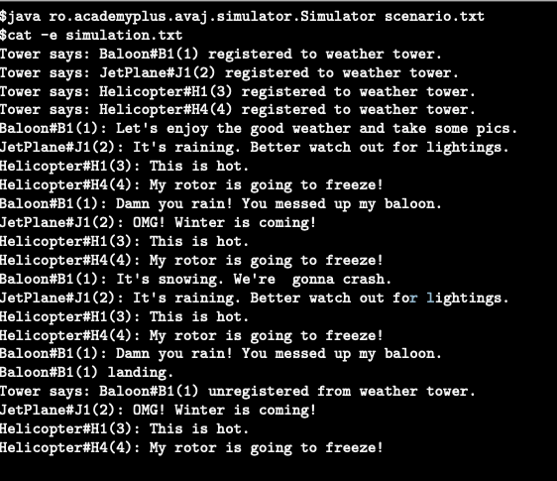

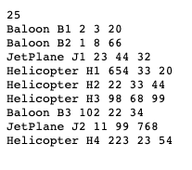
LET'S
COMPILE IT :)
$find -name *.java > sources.txt $javac -sourcepath @sources.txt

Slide 6

QUESTIONS?

